Slide 1
Why Model?
Joshua Epstein
Sixteen Reasons Other Than Prediction to Build Models
Explain (very distinct from predict)
Illuminate core dynamics
Suggest dynamical analogies
Discover new questions
Bound (bracket) outcomes to plausible ranges
Illuminate core uncertainties
Demonstrate tradeoffs / suggest efficiencies
Challenge the robustness of prevailing theory through perturbations
Expose prevailing wisdom as incompatible with available data
Reveal the apparently simple (complex) to be complex (simple)
http://jasss.soc.surrey.ac.uk/11/4/12.html

Slide 2
How can a neuron change its gain?
Integrate and fire model
Hodgkin-Huxley model
Dynamic Clamp
How can a neuron maintain a stable firing pattern?
Crustacean stomatogastric ganglion
Phase constancy
Calcium as a feedback mechanism

Slide 3
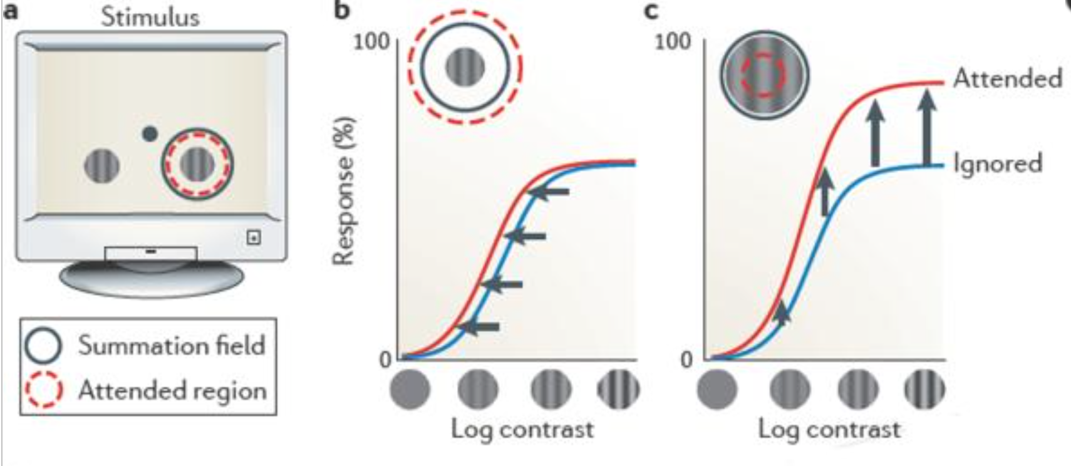
Changing gain in the nervous system
Reynolds & Heeger, 2009

Slide 4
Integrate and fire neuron
- Derivation
- Effect of changing conductance

Slide 5
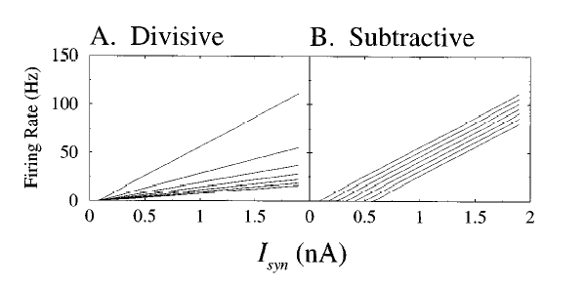
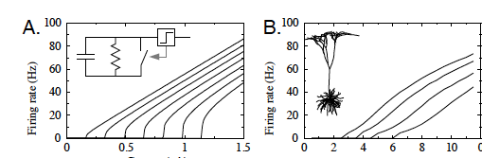
Current (nA) Excitatory synaptic input rate (Hz)
Holt & Koch, 1997. Shunting inhibition does not have a divisive effect on firing rates

Slide 6
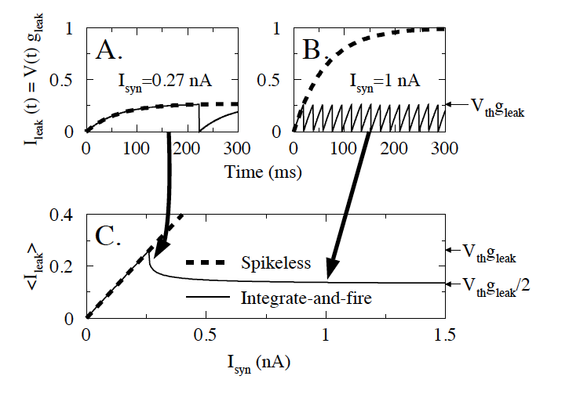
Rapid spiking “clamps” the voltage
making it independent of injected current

Slide 7
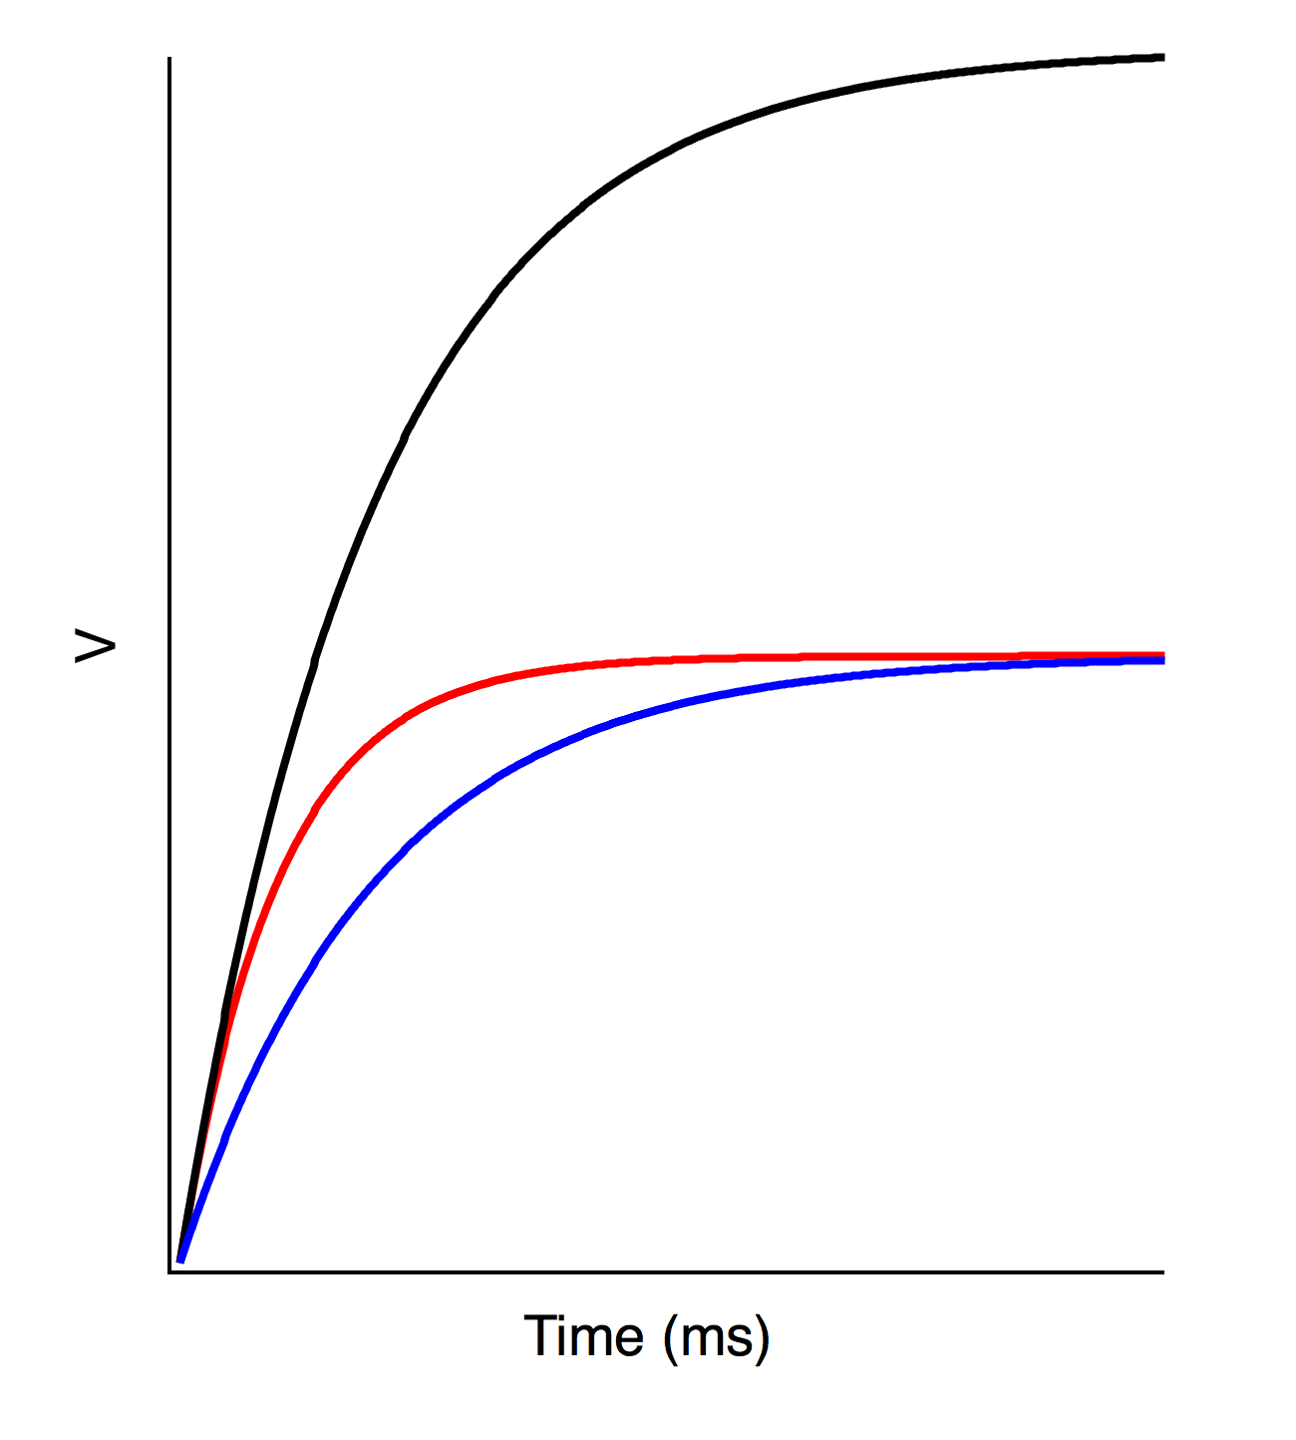
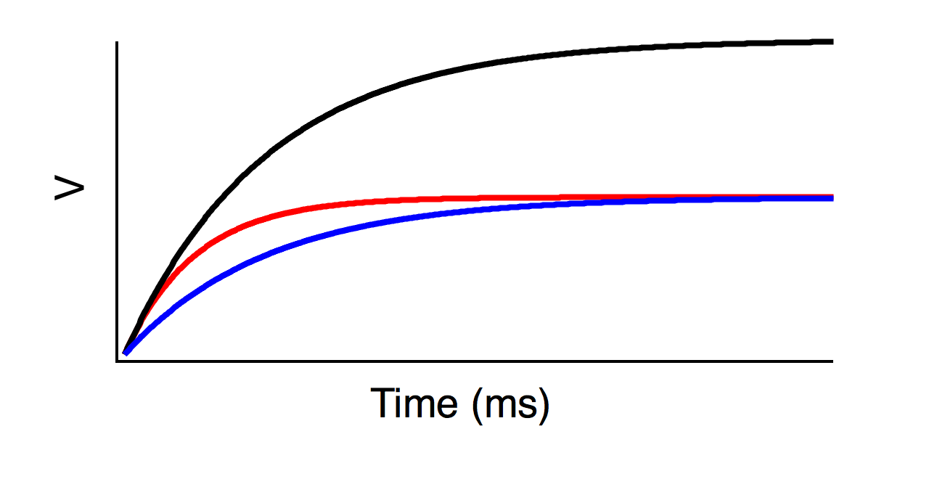
Shunting changes conductance, but also tau
with different effects for small and large currents
Large currents
g, tau
2g, tau
2g, tau/2
Small currents
g, tau
2g, tau
2g, tau/2
V_{thresh}
V_{thresh}

Slide 8
Rate constants
Closed
Open
State
Occupancies
(sum to 1)
R
A
Change in
activity = Inflow – Outflow
Kinetic model

Slide 9
Input and output in a kinetic model
Closed
Open
R
A
Active
Resting
[L]k_{on}
k_{off}

Slide 10
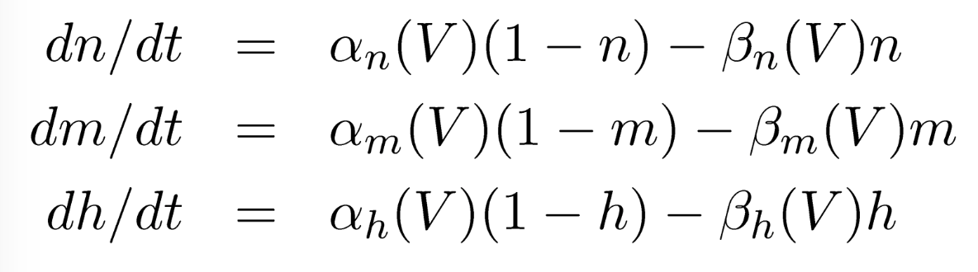
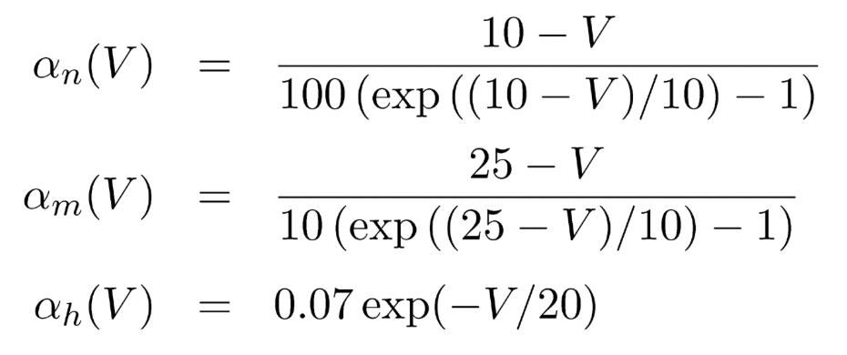
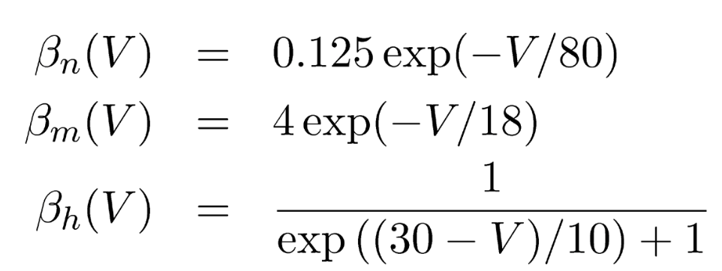
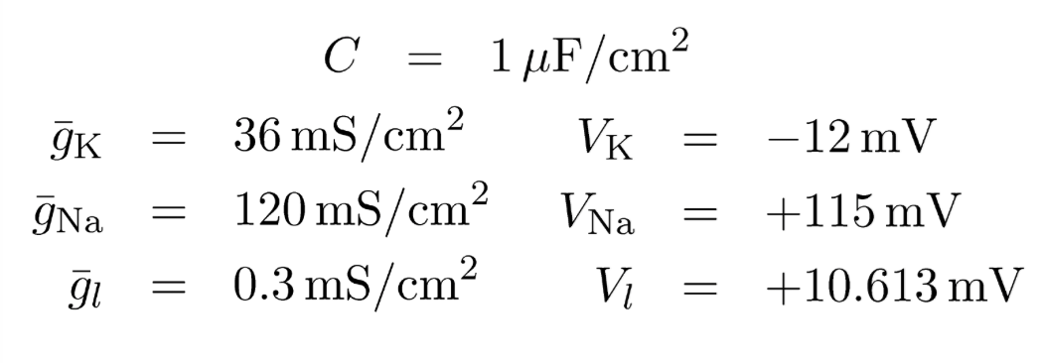
Hodgkin Huxley Model
Voltage state variable (membrane equation):
Conductance state variables:
Rate “constants”:
Constants:
Note: these are given in
the original form,
relative to V_{rest} =~ -66 mV

Slide 11
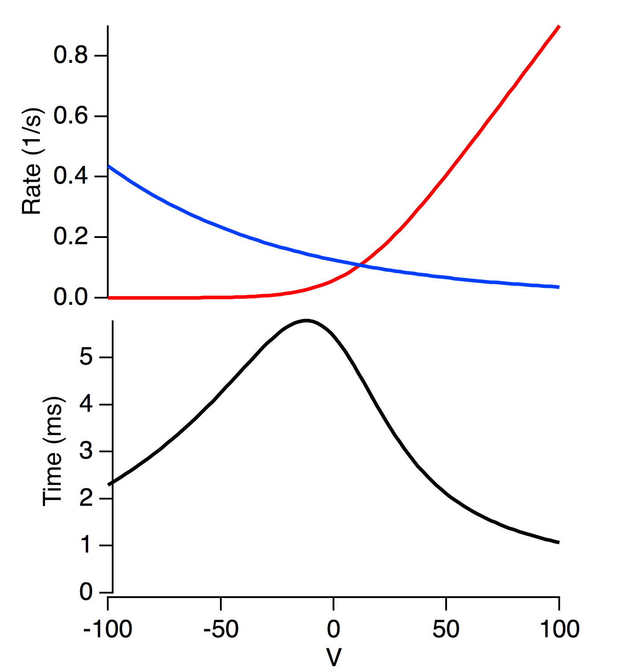
Tau is slow when both rate constants are slow
beta
alpha
Tau=1/(alpha+beta)

Slide 12
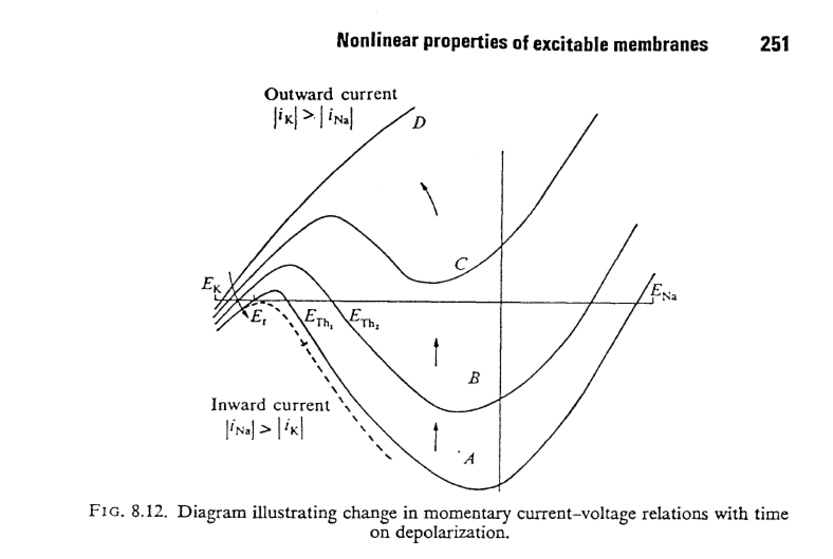
Notes:
This figure is from Jack Noble and Tsien, 1975 p. 251. N-shaped current voltage (I-V) curves are typical of excitable cells and systems. An electronic component with this property is called a tunnel diode. This shows how the I-V curve of an excitable cell changes over time as sodium channels close. The key thing here is the three points where the curve intersects the x-axis. Resting potential, threshold and the peak of the action potential. Also note that when enough inactivation occurs, threshold disappears, and the cell is no longer excitable.

Slide 13
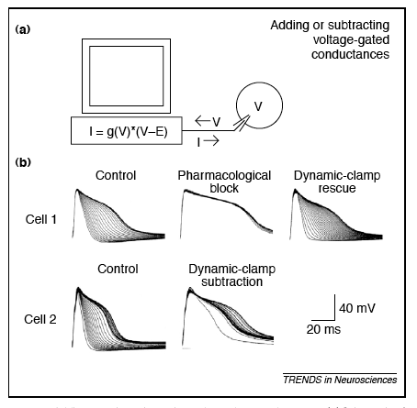
The dynamic clamp
Artificially adding or subtracting membrane mechanisms

Slide 14
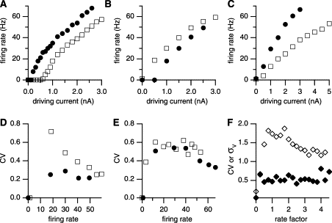
Balanced excitation and inhibition can change gain
Rat somatosensory cortex slice
Shunting inhibition alone
Balanced excitation and inhibition
Chance, Abbott & Reyes. (2002) Gain modulation from background synaptic input.

Slide 15
How can a neuron maintain a stable firing pattern?

Slide 16
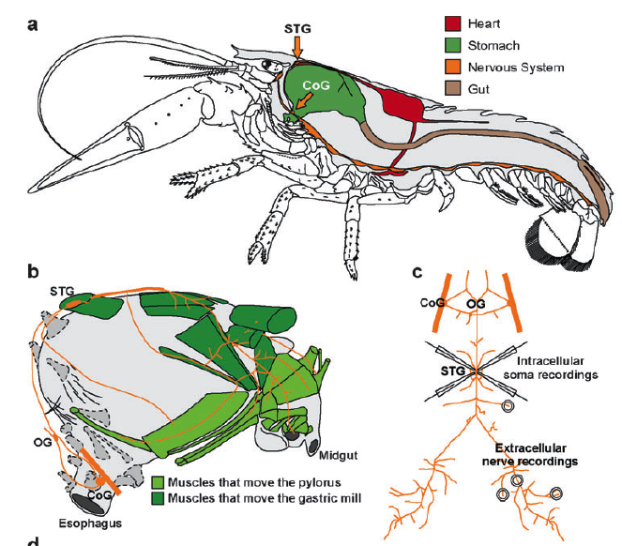
Crustacean stomatogastric ganglion
Marder, E. & Bucher, D., 2006

Slide 17
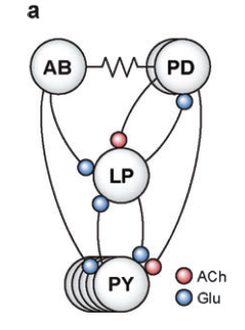
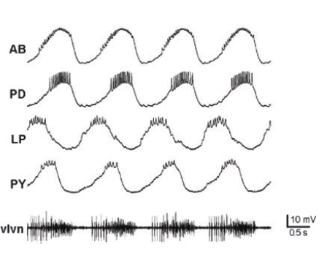
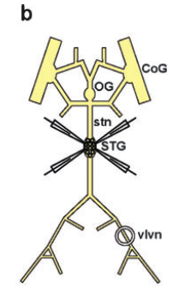
Pyloric oscillator of the stomatogastric ganglion
AB: Anterior burster
PD: Pyloric dilator
LP: Lateral Pyloric
PY: Pyloric
Note: these are inhibitory

Slide 18
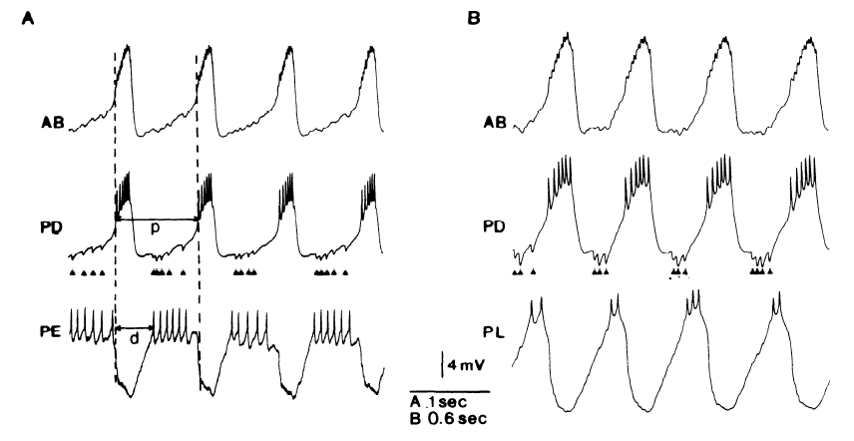
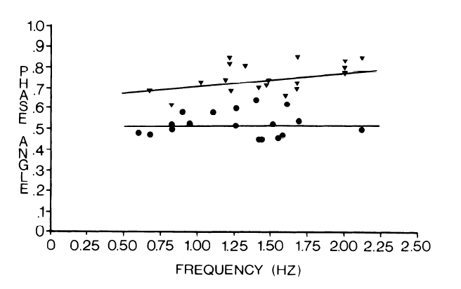
Phase constancy across oscillation frequency

Slide 19
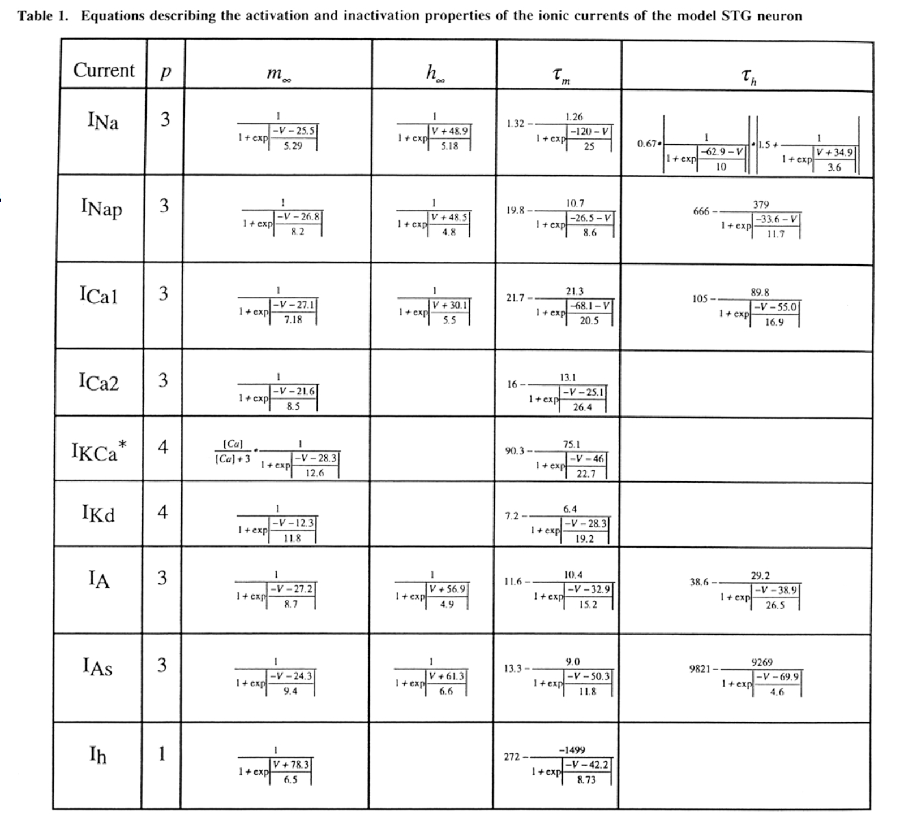
Many conductances, how are they regulated?

Slide 20
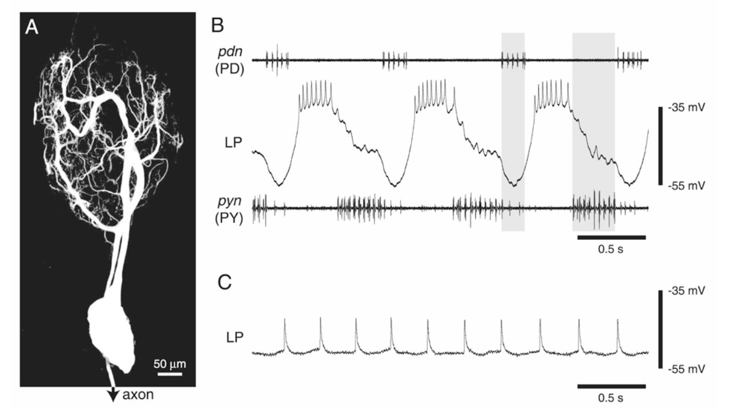

Slide 21
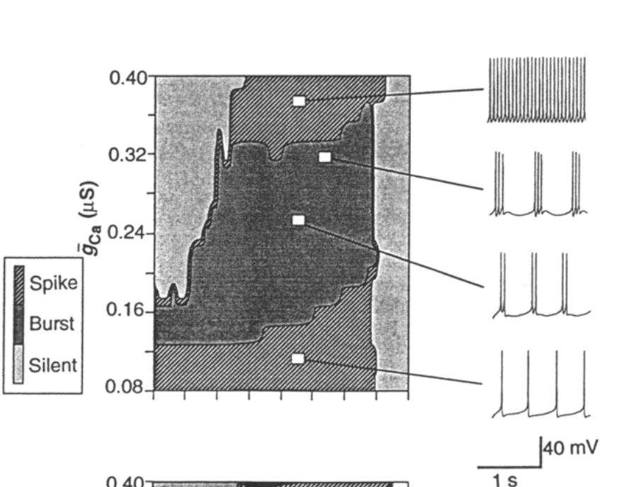
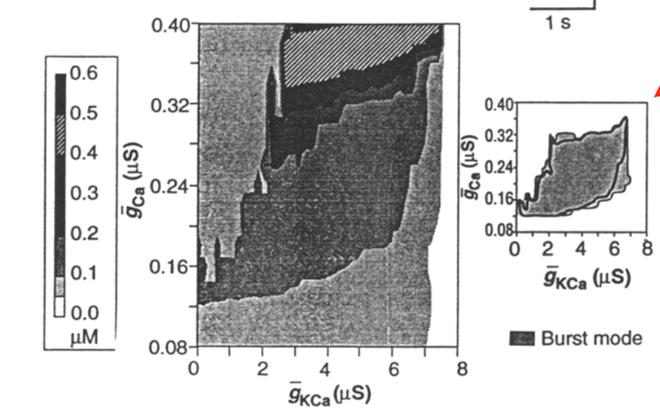
Different dynamic behavior in different regions of parameter space
LeMasson, Abbott and Marder, 1993

Slide 22
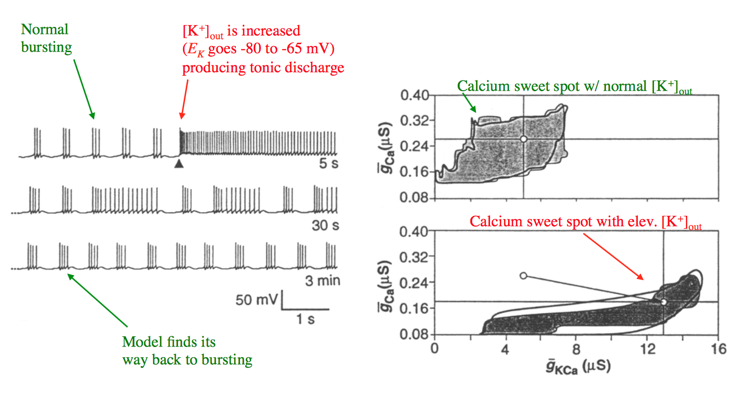
Ca
K+ is increased here, E_{K} changed from – 80 to -60 mV
Normal K+
Bursting
[Ca] 0.1 – 0.3 mM
Elevated K+
Change in model behavior
Returns to bursting

Slide 23
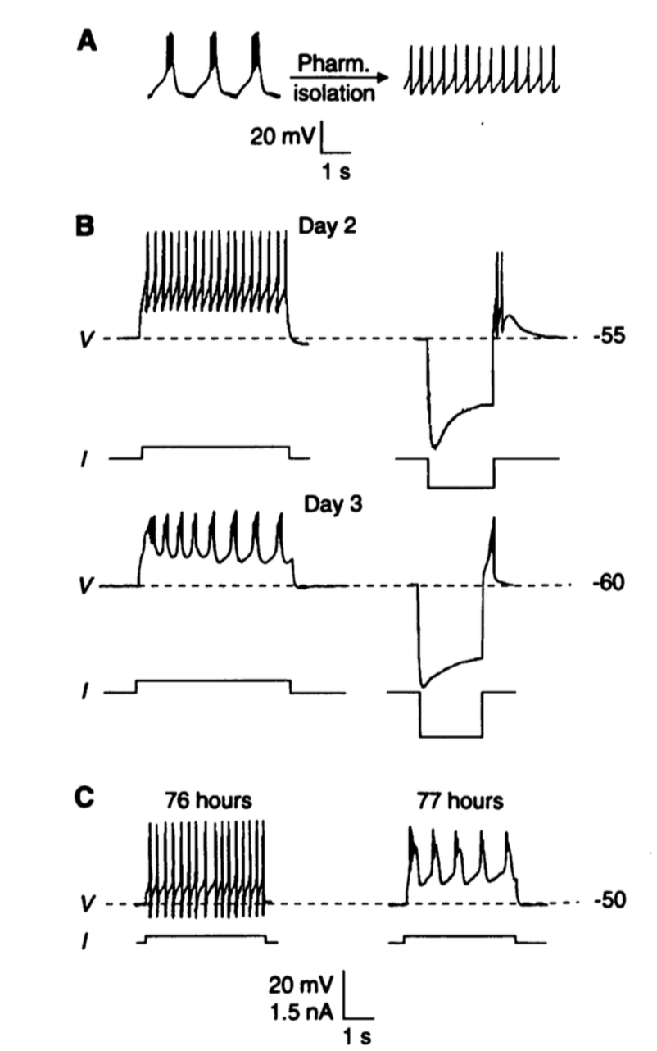
Cells change their physiological properties to burst
Turrigiano et al., 1994

Slide 24
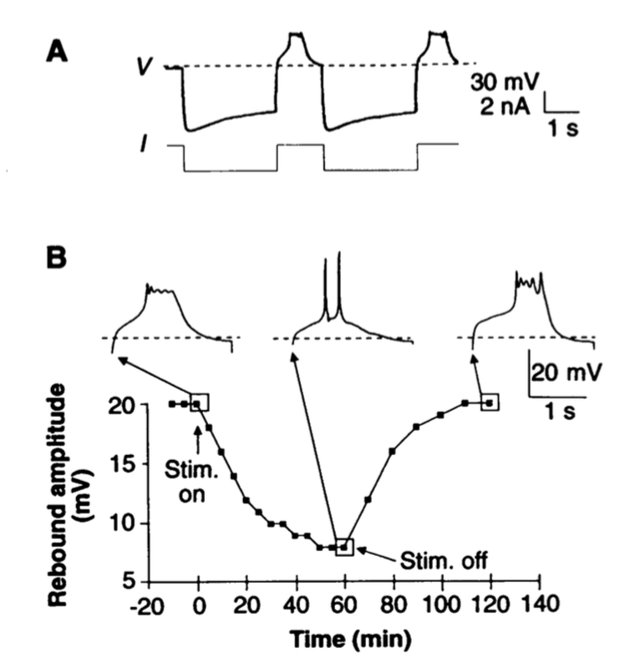

Slide 25
What influence do dendrites have on computation?

Slide 26
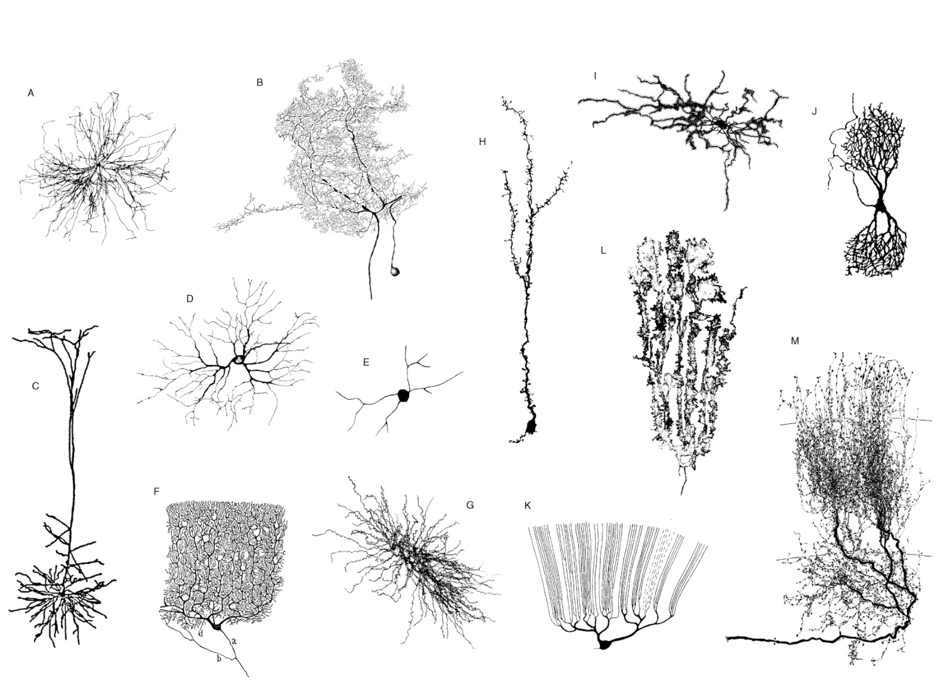

Slide 27
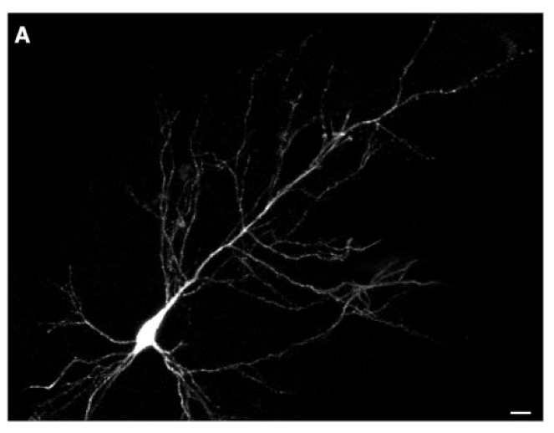
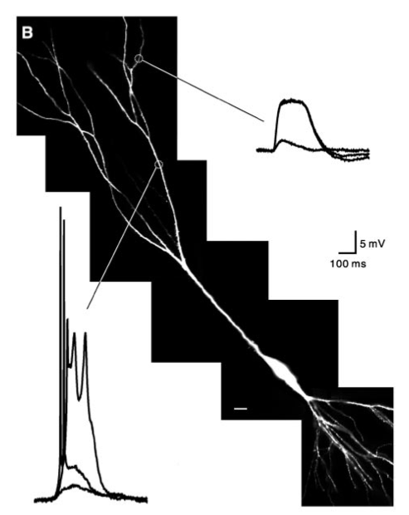
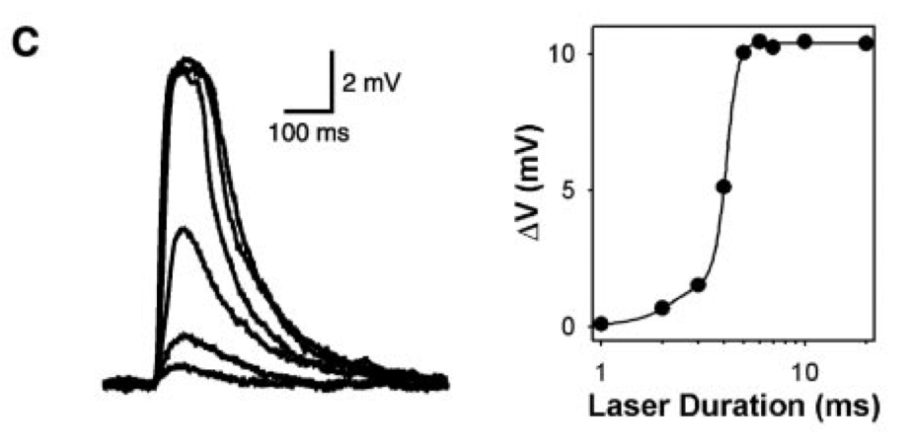
All or none calcium action potentials in pyramidal cell dendrites
Wei et al., 2001. Compartmentalized and Binary Behavior of Terminal Dendrites in Hippocampal Pyramidal Neurons
Notes:
Calcium action potentials can be measured in some dendrites. Here, caged glutamate is being released onto a cell. This is a synthetic glutamate analog that is inactive, because there is an additional molecule attached to the glutamate. When light is absorbed by the molecule, it cleaves, releasing glutamate that then can bind to glutamate receptors.
Calcium action potentials occur when the cell depolarizes sufficiently to open a large calcium current, which then further depolarizes the cell producing positive feedback. Eventually (~50 – 100 ms) calcium channels inactivate (close), even though the cell is still depolarized, thereby ending the action potential.

Slide 28
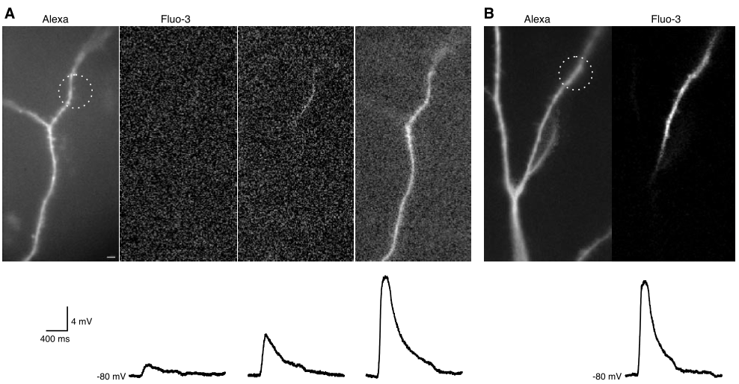
Action potential failure at a dendritic branch point
Wei et al., 2001. Compartmentalized and Binary Behavior of Terminal Dendrites in Hippocampal Pyramidal Neurons
Notes:
A. Left, a fluorescent dye fills the cell, showing its dendrites. Next three panels: Three different levels of caged glutamate are released onto the cell, eventually producing a calcium action potential. The dye Fluo-3 is a calcium senstiive dye that fluoresces when it binds calcium. Thus the calcium influx from the action potential can be directly imaged. B. The calcium action potential fails to invade the entire cell and fails at a branch point, because the greater capacitance of membrane near the branch point can’t be depolarized by the currents in the smaller branch where the action potential originated.

Slide 29
Properties of feature detection
Selectivity
Invariance

Slide 30
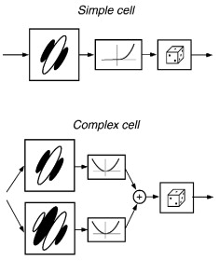
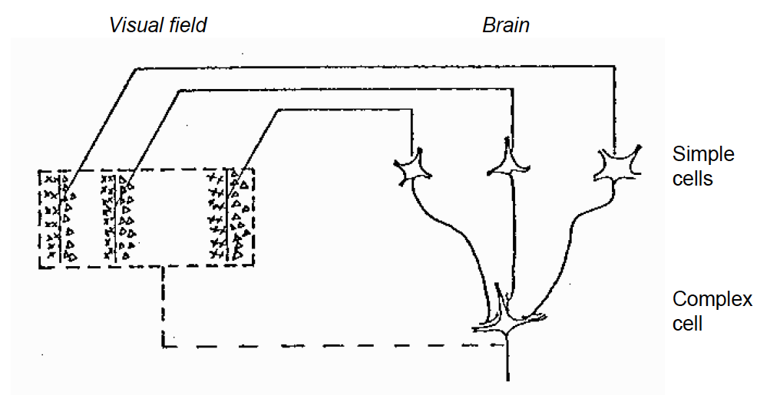
Models of selectivity and invariance in primary visual cortex
Hubel & Wiesel, 1963
Rust et al., 2005

Slide 31
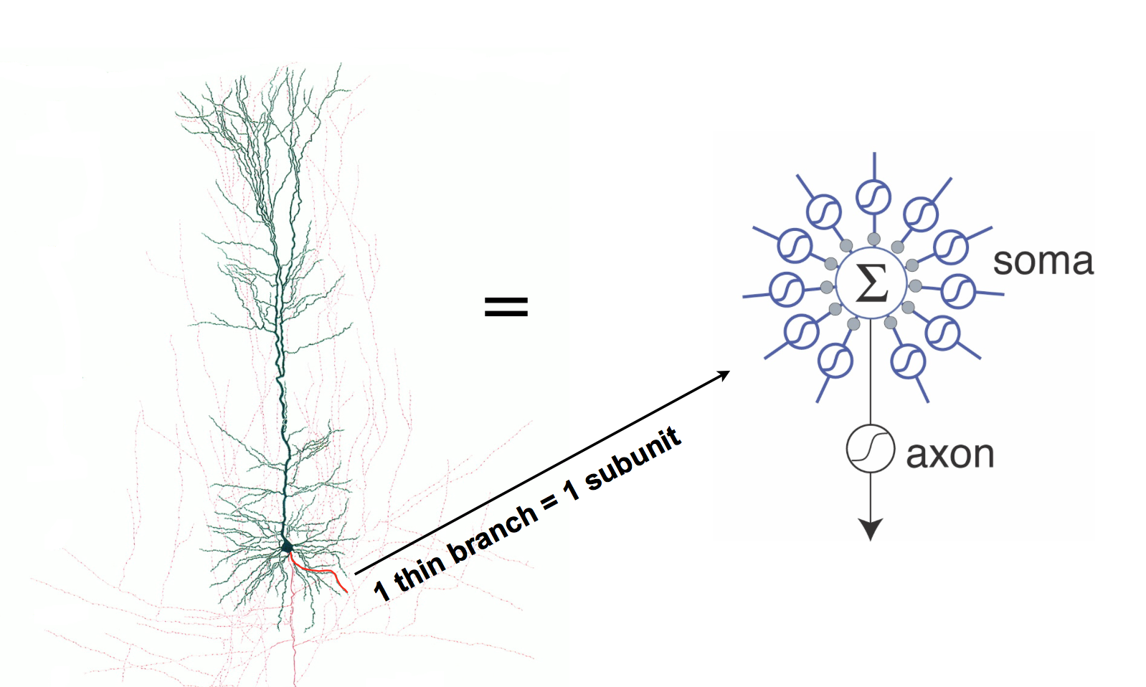
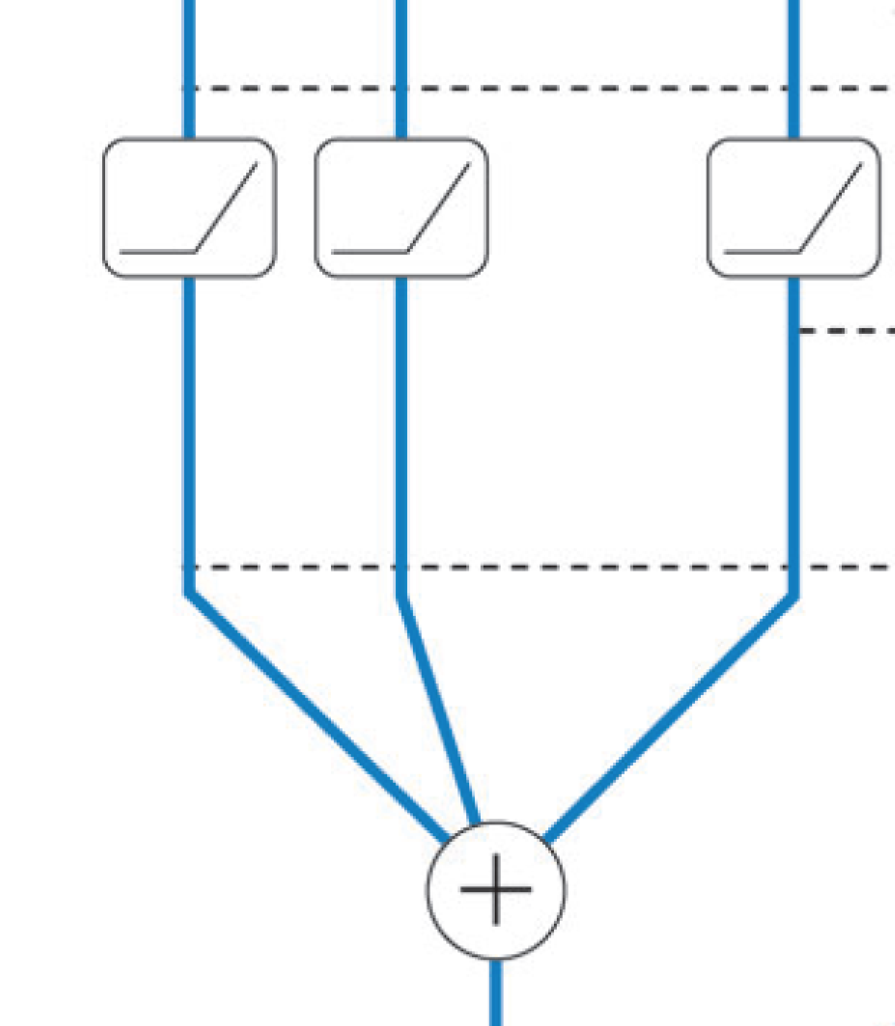

dendrites
soma
axon

Slide 32
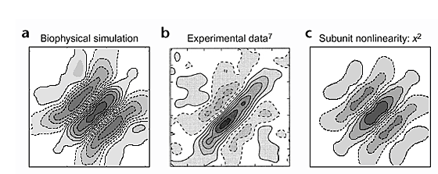
Model of Binocular Disparity Representation
Bar presented to left & right eyes
Right eye pos. (deg)
Left eye pos. (deg)
Archie & Mel (2000)

